Slide 1








Project Cost Management
1

Slide 2



Table of content
Why Do We Need Cost Management?
Advantage of Cost Management
Case study
What Is Cost Management?
Cost Management Overview
How Do We Manage Cost?
Plan Cost Management
Estimate Costs
Determine Budget
Control Costs
Cost Management In Agile
Summary

Slide 3


Course Objectives
Understand what cost management is and
how important it is.
Know the processes required for cost management.
Understand cost management practices in
Agile.

Slide 4
WHY DO WE NEED COST MANAGEMENT?

Slide 5




Advantage Of Cost Management
Lowers Expenses
Limit the amount of money different type of resource can spend, keeping more money from going out the door.
Enhanced Efficiency
Identify activities running smoothly and staying within budget from the ones constantly breaking down and consuming extra dollars.
Streamline Technology
Promote tool development to improve productivity and save cost.

Slide 6

Case study #1
To implement a feature requested by the client, the project manager requested project technical leader to research for this. It took 2 weeks for him to research and complete. Then, the project manager decided to organize a meeting to demo this feature for all members. During this demo, a project member said that he has seen this feature in a project he participated in the past and it ONLY take about 2 days to refer source code of that project and customize for the feature required by the customer this time.
In your opinion, what are the ways to save costs effectively?

Slide 7

Case study #2
To optimize the cost, the project manager decided to use almost junior resources. At the end of the first milestone there were many quality issues that resulted in an extremely high re-work. In addition, because of great re-work effort, the ability to miss deadline of the next milestone is very high. In order to encourage members to finish tasks on time, project manager had to apply for campaign program and also he must paid overtime cost. These caused actual cost was 2 times higher than the cost planned.
Has your project ever encountered similar situation?
THE TRUE COST OF A BAD HIRE!

Slide 8
WHAT IS COST MANAGEMENT?

Slide 9
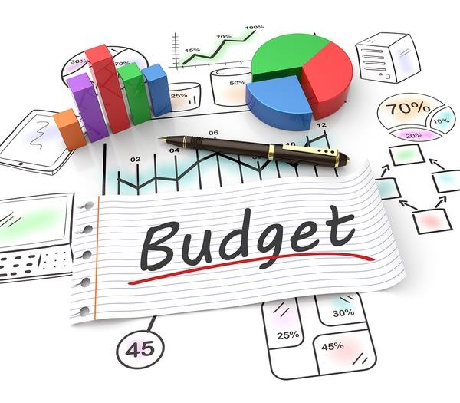
Cost Management Overview
Project Cost Management includes the processes involved in planning, estimating, budgeting, financing, funding, managing, and controlling costs so that the project can be completed within the approved budget.

Slide 10
HOW DO WE MANAGE COST?

Slide 11
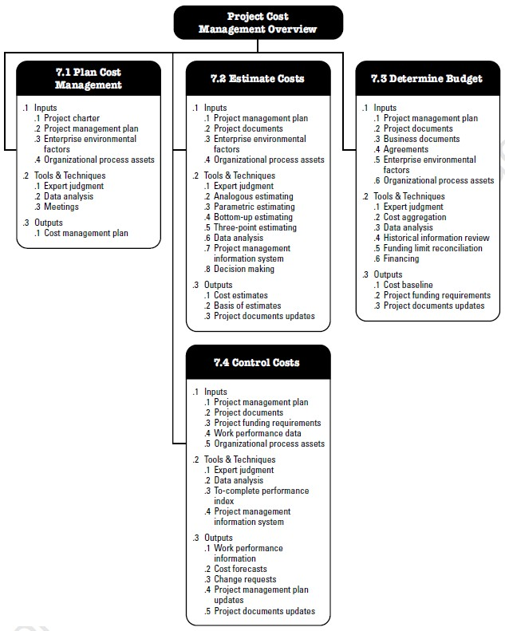
Cost Management Processes

Slide 12
Plan Cost Management
Plan Cost Management is the process of defining how the project costs will be
estimated, budgeted, managed, monitored, and controlled.
INPUTS
TOOLS & TECHNIQUES
OUTPUTS
Project charter
Project management plan
Enterprise environmental factors
Organizational process
assets
Expert judgment
Data analysis
Meetings
.1 Cost management plan

Slide 13
Output: Cost Management Plan
Units of
measure
Reporting
formats
Level of precision
Cost Management Plan
Rules of performance measurement
Control
accounts
Control
thresholds

Slide 14
Estimate Costs
Estimate Costs is the process of developing an approximation of the cost of resources
needed to complete project work.
INPUTS
TOOLS & TECHNIQUES
OUTPUTS
Project management plan
Project documents
Enterprise environmental
factors
Organizational process
assets
Expert judgment
Analogous estimating
Parametric estimating
Bottom-up estimating
Three-point estimating
Data analysis
Project management
information system
Decision making
Cost estimates
Basis of estimates
Project documents
updates

Slide 15
Technique: Estimation Method
Analogous estimating
Uses values, or attributes, of a previous project that are similar to the current project.
Example: If it need 2,000 hours to develop a website a few months ago and you are responsible for developing a new similar website, you estimate it need 2,000 hours to finish.
Parametric estimating
Uses a statistical relationship between relevant historical data and other variables to calculate a cost estimate for project work.
Example: If an activity needs 4,000 hours of coding and it needs to finish it in 1 year, it will require two people to code (each
doing 2,000 hours a year).
Bottom-up estimating
The detailed cost of work package or activities are summarized to higher levels.
Example: If a project includes 10 work packages and each work package needs 200 hours to be completed, it will take 2000 hours to finish this project.
Three-point estimating
Triangular distribution: (tO + tM + tP)/ 3
Beta distribution : (tO + 4tM + tP)/ 6
Most likely: tM
Optimistic: tO
Pessimistic: tP
Example: If an activity with tO = 4 hours , tM = 8 hours , tP = 16 hours, it will take (4+8+16)/3 = 9.3 hours to finish.

Slide 16

Technique: Data analysis – Reserve analysis
Cost estimates may include contingency reserves to account for cost uncertainty.
Example: rework cost for some project deliverables
The contingency reserve may be:
Percentage of the estimated cost
Fixed number
Use quantitative analysis methods

Slide 17
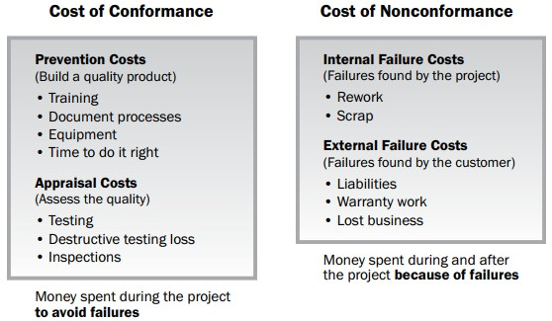
Technique: Data analysis – Cost of Quality
Use assumptions about cost of quality to prepare the estimates.

Slide 18

Output: Cost estimates
Cost required to complete project work
Cost estimates
Contingency amounts to account for identified risks

Slide 19
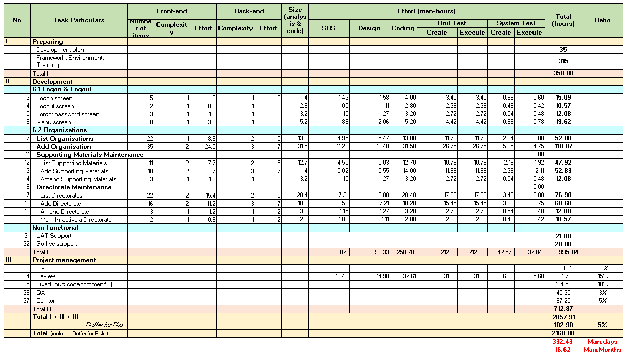
Output: Cost estimates (cont)
Refer link https://qms.fsoft.com.vn/#/upload-document/809/809/view

Slide 20
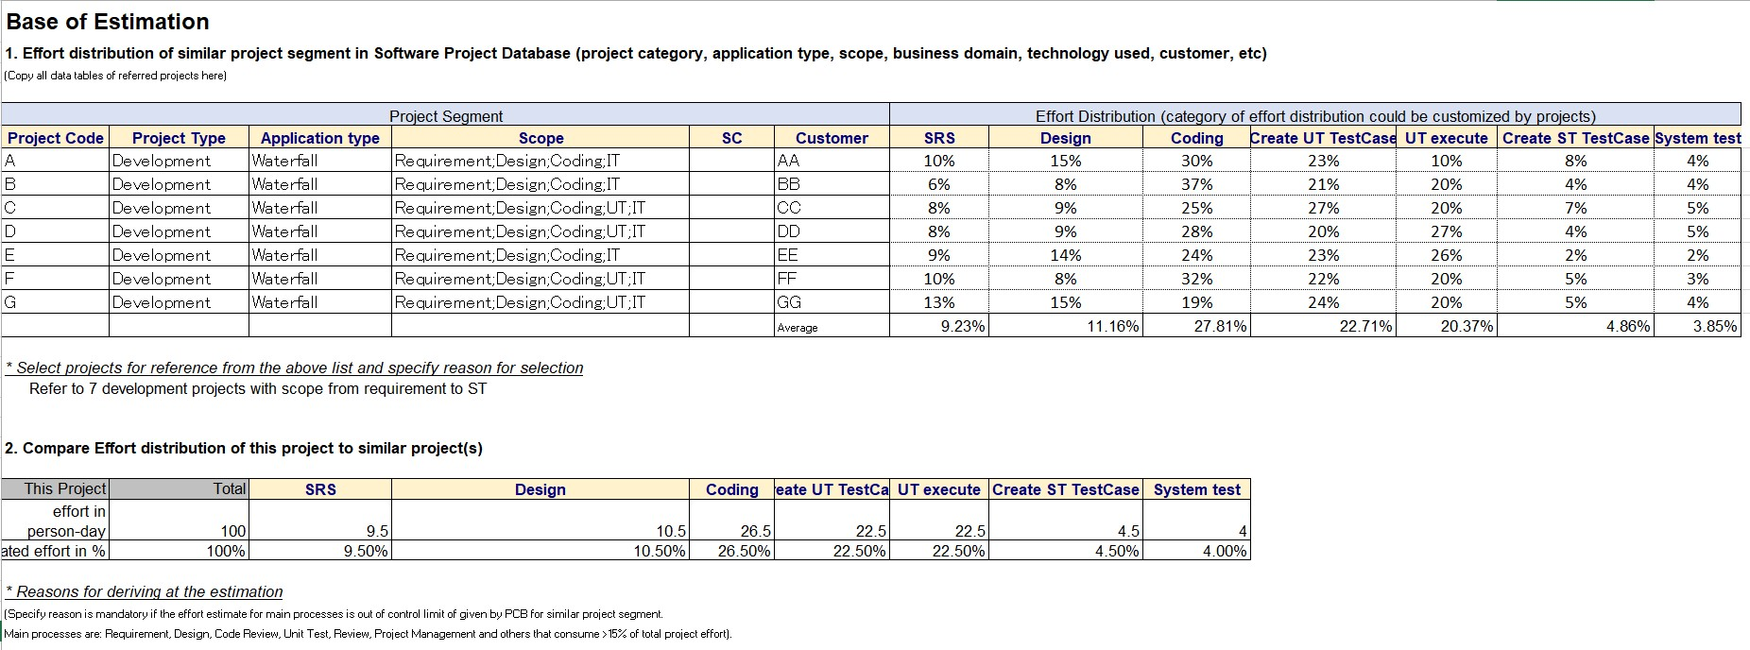
Output: Basis of estimates

Slide 21
Determine Budget
Determine Budget is the process of aggregating the estimated costs of individual
activities or work packages to establish an authorized cost baseline.
INPUTS
TOOLS & TECHNIQUES
OUTPUTS
Project management plan
Project documents
Business documents
Agreements
Enterprise environment
factors
Organizational process
assets
Expert judgment
Cost aggregation
Data analysis
Historical information review
Funding limit
reconciliation
Financing
Cost baseline
Project funding requirements
Project documents updates

Slide 22
Output: Cost baseline
Approved version of the time-phased project budget, used as a basis for comparison
to actual results.
Project Budget
Management Reserve
Cost Baseline
Control Accounts
Contingency
Reserve
Work Package
Cost Estimates
Activity
Contingency
Reserve
Activity Cost Estimates

Slide 23

Output: Project funding requirements
Unit cost_{avg BU}
BMM
K
Average Expenses of BU
Salary
Other expenses for project work
Insurance
13th month salary
Project income
Size of project
Get from PO
Adjustment coefficient
0.5~1.5

Slide 24
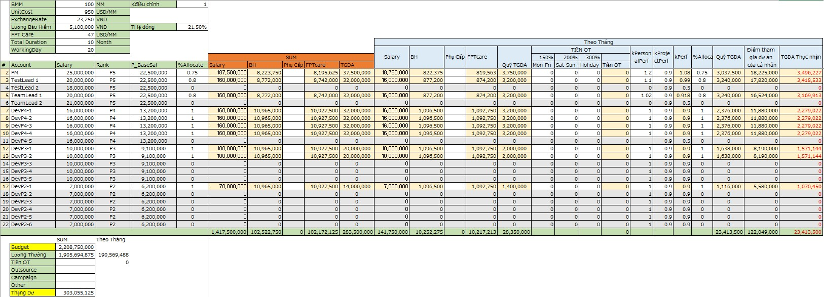
Output: Project funding requirements (cont)

Slide 25
Control Cost
Control Costs is the process of monitoring the status of the project to update the
project costs and managing changes to the cost baseline.
INPUTS
TOOLS & TECHNIQUES
OUTPUTS
Project management plan
Project documents
Project funding
requirements
Work performance data
Organizational process
assets
Expert judgment
Data analysis
To-complete performance
index
Project management
information system
Work performance information
Cost forecasts
Change requests
Project management plan
updates
Project documents
updates

Slide 26
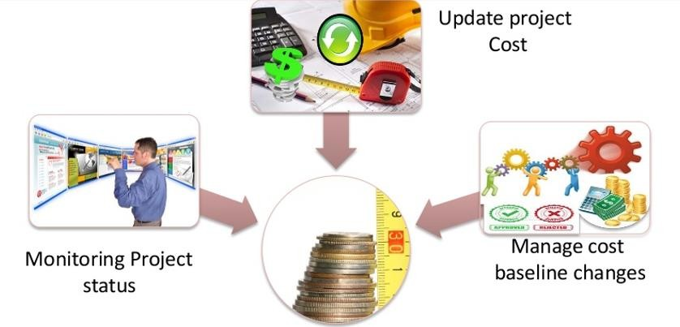

Technique: Data analysis – Variance analysis
Monitoring the status of the project to update the project costs & managing changes to
the cost baseline
Provides the means to recognize variance from the plan in order to take corrective action
and minimize risk
Plan Cost
Actual Cost

Slide 27
Technique: Data analysis – Variance analysis (cont)
Cost of project includes:
Salary
BaseSal_P of members
Insurance
13th month salary
Project income
Overtime
Overtime salary
Compensatory leave
Rental cost
Campaign Equipment fee
Tool, Equipment, License

Slide 28
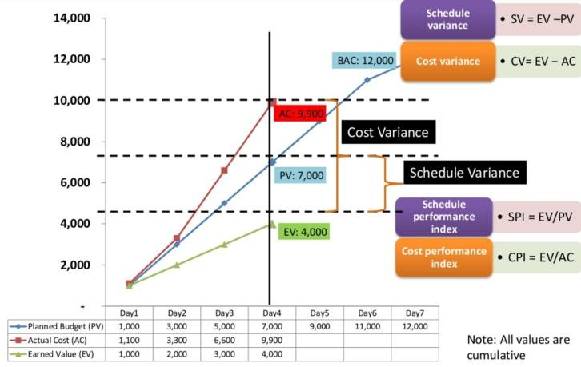
Output: Work performance information & Cost forecast
PV: Planned value EV: Earned value AC: Actual cost

Slide 29
COST MANAGEMENT IN AGILE

Slide 30
Consideration for Agile model
Use lightweight estimation methods for a fast, high-level
forecast of project labor costs.
Use detailed estimates for short-term planning horizons in a
just-in-time fashion.
Strict budgeting for high variability projects will require the scope and schedule adjustments to stay within cost constraints.

Slide 31
SUMMARY

Slide 32







Summary
Use an appropriate
estimation method
Include contingency reserves to account for cost uncertainty.
Clarify budget at the start of
the project (K adjustment)
Control cost as a continuous
progress

